Slide 1
BATTULA KOTESWRARAO
KEYLOGGER PROJECT

Slide 2
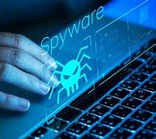
KEYLOGGER
keylogger is an insidious form of spyware. It's also a legal and sometimes ethical tool to monitor the activity of employees and even your kids as they interact online. Keyloggers give hackers access to your personal data, such as account passwords, when used for nefarious purposes.
It may come as no surprise that keyloggers have been used for spying on people since the beginning of computers. According to Wikipedia, keyloggers were used for many different purposes in the 1970s and early 1980s, including secret government operations

Slide 3


AGENDA
Introduction
Problem Statement
Project Overview
End UsersSolution and Value Proposition
The "Wow" Factor in Our Solution
Modelling
Results
Conclusion and Q&A
3/21/2024 Annual Review

Slide 4

PROBLEM STATEMENT
Keyloggers are type of malware that can steal sensitive information from device such as passwords , card numbers, messages. If this data falls into the wrong hands, it can lead to serious consequences, including identity theft, financial loss, and fraud. The increasing prevalence of keyloggers poses a significant threat to digital security, compromising the confidentiality and integrity of sensitive information
Keyloggers pose a threat to the security of an organization’s sensitive data and systems. When sensitive data such as passwords is typed into a computer, there are no protections in place preventing it from being collected by malware. A keylogger can steal sensitive data that can be used for various purposes effects the personal details of the individuals, financial loss, identity thefts

Slide 5

PROJECT OVERVIEW
This project aims to address the critical need for effective detection and prevention methods against keyloggers. It will explore the current landscape of keylogger technology, evaluate existing security measures, and develop innovative solutions to enhance protection against these threats. By doing so, the project seeks to mitigate the risks associated with keyloggers, safeguard personal and organizational data, and promote a secure digital environment.
keylogger, short for keystroke logger, is a type of cyber threat that records the keys struck on a keyboard, typically covertly, so the person using the keyboard is unaware that their actions are being monitored. This enables attackers to gain unauthorized access to confidential.

Slide 6

WHO ARE THE END USERS?
Keyloggers, also known as keystroke loggers or system monitors, can have many end users, including individuals, businesses, and government . Even Parents can use keyloggers to monitor their children's online activities, such as screen time, WhatsApp interactions, call logs, and location. The major end users are
Employers: can use keyloggers to monitor employee productivity and behavior, especially in remote work environments. This can help ensure employees adhere to company policies, such as cybersecurity and data leak .
Information technology departments :can use keyloggers to troubleshoot issues on a device.
Security professionals and ethical hackers :can use keyloggers to identify vulnerabilities in computer systems and networks.
Cybercriminals: can use keyloggers to steal sensitive information, such as passwords, credit card numbers, and personal data. This information can be used for identity theft, financial fraud, or other criminal activities.

Slide 7

YOUR SOLUTION AND ITS VALUE PROPOSITION
Anti-Key-logger – As the name suggest these are the software which are anti / against key loggers and main task is to detect key-logger from a computer system.
Anti-Virus – Many anti-virus software also detect key loggers and delete them from the computer system. These are software anti-software so these can not get rid from the hardware key-loggers.
Automatic form filler – This technique can be used by the user to not fill forms .
One-Time-Passwords – Using OTP’s as password may be safe as every time we login we have to use a new password.
Patterns or mouse-recognition – On android devices used pattern as a password of applications and on PC use mouse recognition, mouse program uses mouse gestures instead of stylus.

Slide 8

THE WOW IN YOUR SOLUTION
Data Theft: - *Sensitive Information*: Keyloggers can capture passwords, credit card numbers, personal identification numbers (PINs), and other sensitive information. - *Corporate Espionage*: In a corporate setting, keyloggers can steal proprietary information, trade secrets, and confidential business communications.
Privacy Invasion : - *Personal Privacy*: Keyloggers can compromise personal privacy by recording emails, chat conversations, and other personal communications. - *Surveillance*: They can be used by malicious individuals to monitor and control the activities of the user.
Financial Loss : - *Unauthorized Transactions*: Captured financial information can lead to unauthorized transactions and fraud.
8

Slide 9
COMPONENTS
Key Event Listener : - Captures keystrokes as they are typed. - This can be implemented using low-level system hooks or higher-level APIs provided by the operating system.
Data Storage : - Stores captured keystrokes in a file or sends them to remote server. Ensure data is stored securely to prevent unauthorized access.
Data Transmission (Optional): - Transmits the logged data to a remote location. - This involves network programming and secure communication protocols
Stealth Mechanisms : - Ensures the keylogger runs undetected. - Involves hiding processes, files, and network activity.
9

Slide 10
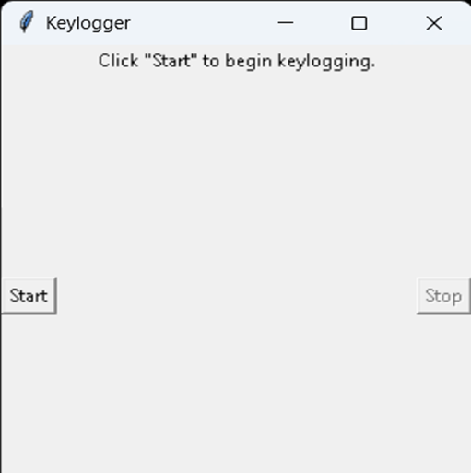
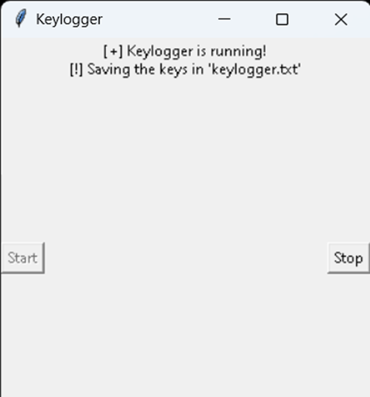
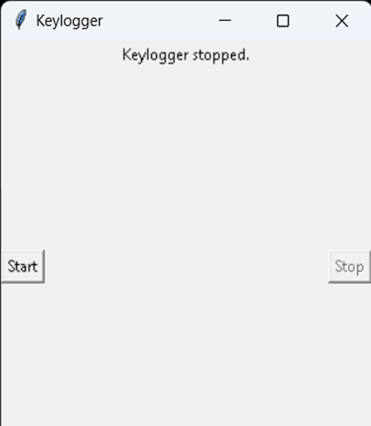
RESULTS
The result of a keylogger program typically involves capturing and logging keystrokes entered by a user on a keyboard. These logged keystrokes can then be used for various purposes, depending on the intent of the keylogger user. The covert nature of keyloggers allows them to capture sensitive information, including passwords, personal messages, and financial details, without the user's knowledge or consent.
10

